Slide 1
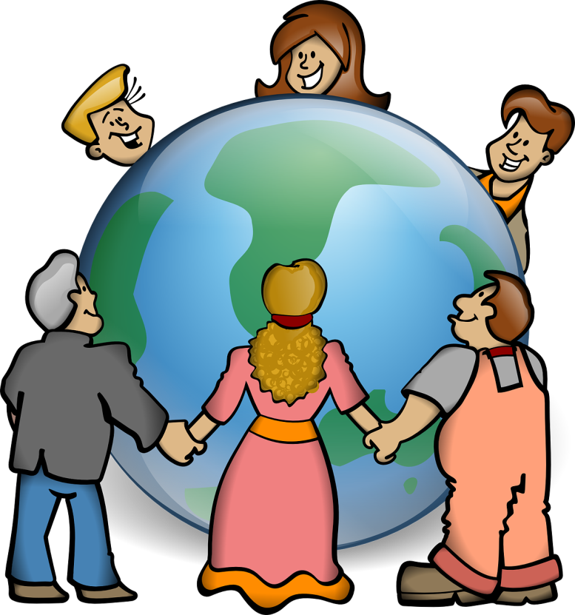
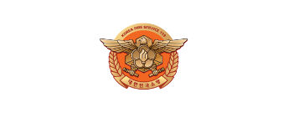
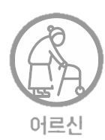
[Episode.8]
Fire Safety
in Winter
Disabled
Woman
Elderly
Foreigner

Slide 2
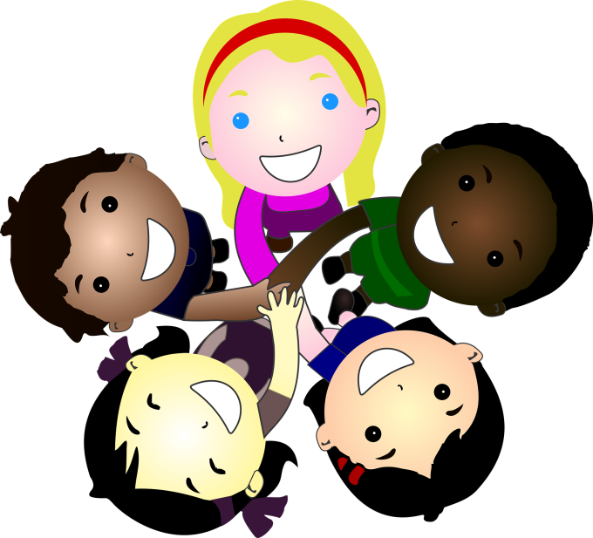
Contents
[Episode.8 ]
Fire Safety in Winter
1. Fire Prevention In Winter_ 2p
2. When Clothes Catch A Fire_ 7p
3. When You Get Burned_ 10p
Disabled
Woman
Elderly
Foreigner

Slide 3
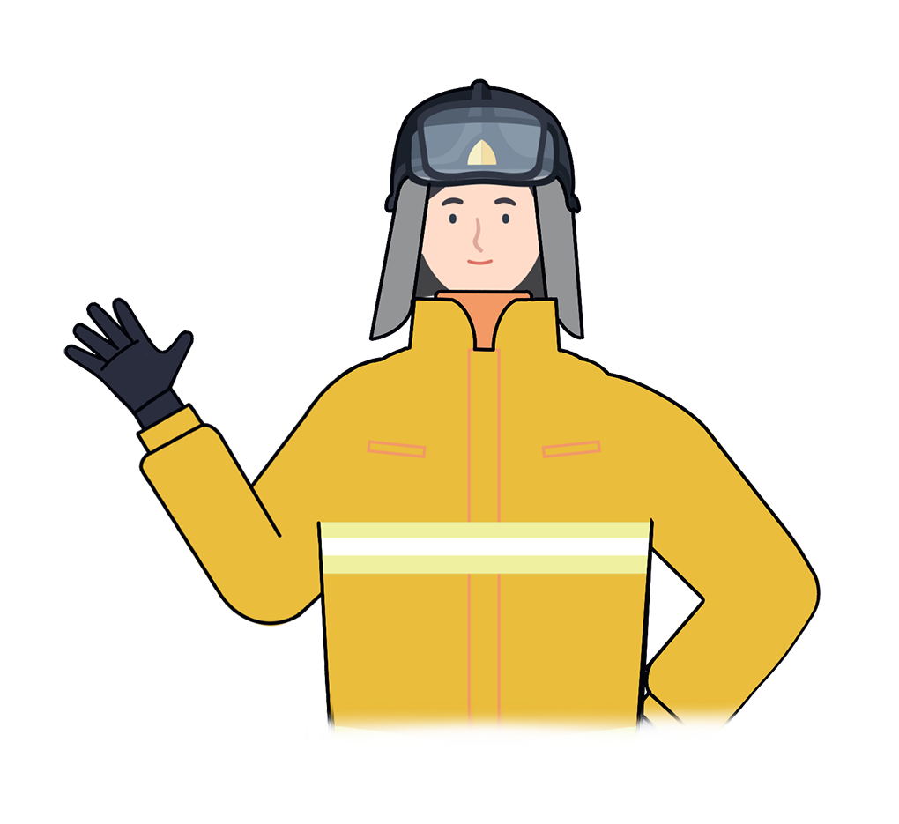
1
Fire Prevention in Winter
“
Winter in Korea starts in December with the cold air from Siberia causing a chilling feeling
This cold air starts from December to February and the temperature always remains below 0 degrees. The weather with severe snowfall makes the demand for heating appliances increase and fire caused by heating appliances also increases rapidly.
“
Disabled
Woman
Elderly
Foreigner

Slide 4
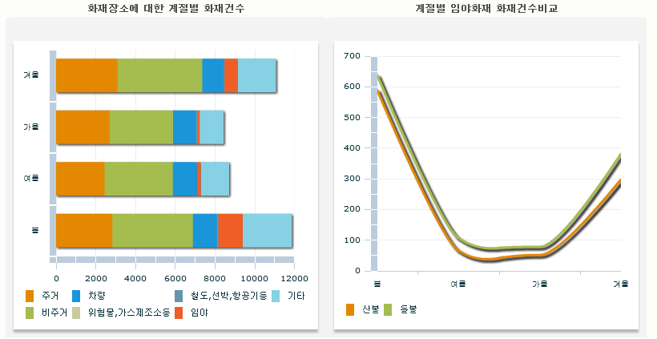
1
Fire Prevention in Winter
Statistics of seasonal fire
Numbers of fires by season and locations
Number of forest fires by season
Winter
Autumn
Summer
Spring
Spring
Summer
Autumn
Winter
Unhabited
Vehicle
Railroad, Ship, Plane
Others
Uninhabited
a dangerous thing,
gas manufacturing station
Forest
Forest
Fires
Wildfires
National Fire Data System(www.firedata.go.kr), Seasonal fire statistics
Disabled
Woman
Elderly
Foreigner

Slide 5
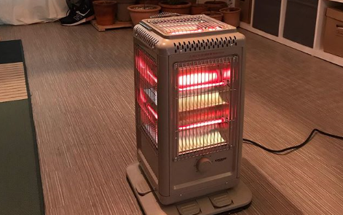
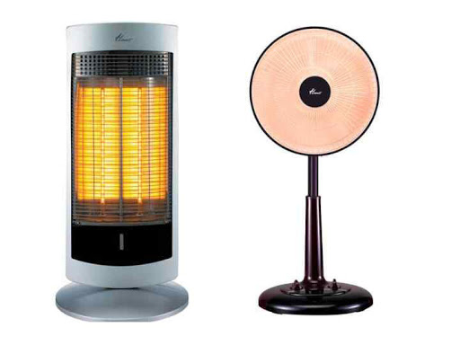
1
Fire Prevention in Winter
In winter, demand for heating appliances increases, which is the cause of many fires
There should be a habit of carefully reading the user manual and following the safety rules for heating and floor heating appliances
Disabled
Woman
Elderly
Foreigner

Slide 6
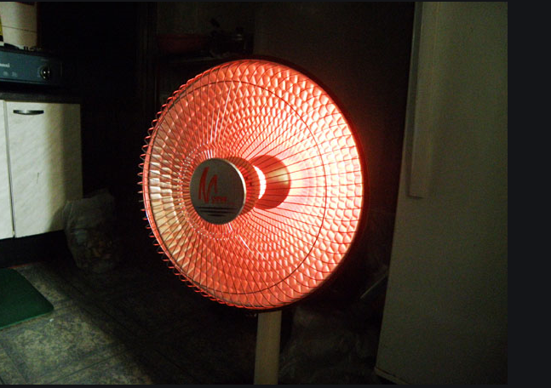
1
Fire Prevention in Winter
Over 1 meter
Keep a distance of over 1 meter between heater and combustible objects
Disabled
Woman
Elderly
Foreigner

Slide 7
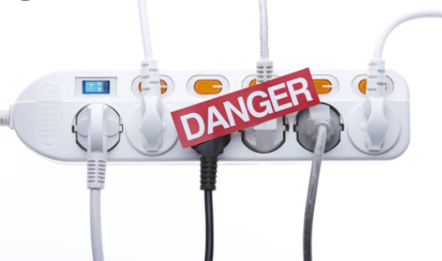
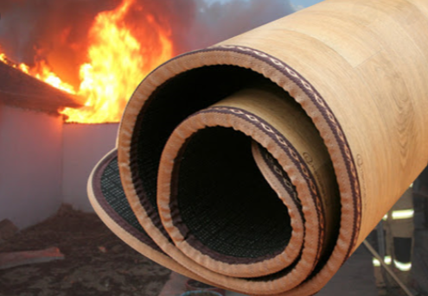
1
Fire Prevention in Winter
Do not plug too many electrical appliances into an electrical outlet
Do not curl or put pressure on electric heating mat
Disabled
Woman
Elderly
Foreigner

Slide 8
2
When Clothes Catch a Fire
“
When you go back home from a freezing cold weather outside and stay close to a heater for warm and your clothes catch a fire.
What do you need to do?
“
Disabled
Woman
Elderly
Foreigner

Slide 9
2
When Clothes Catch a Fire
First, stand still and do not move
Cover your eyes, nose, and mouth to avoid burns on the face and to not inhale smoke
Disabled
Woman
Elderly
Foreigner

Slide 10
2
When Clothes Catch a Fire
Next, lie face down
Third, roll until the fire is put out
If there are people around, use a shirt or blanket to beat hard to extinguish the fire
Disabled
Woman
Elderly
Foreigner

Slide 11
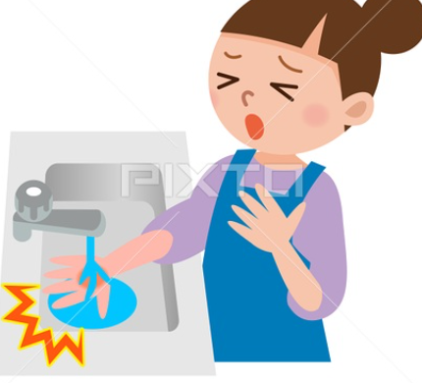
3
When You Get Burned
When you get burned,
cool the burn with cold water
for 20 minutes
Disabled
Woman
Elderly
Foreigner

Slide 12
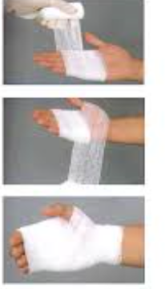
3
When You Get Burned
Wet a medical gauze with salt water,
then wrap it around the burn
to reduce pain and avoid infection
Disabled
Woman
Elderly
Foreigner

Slide 13
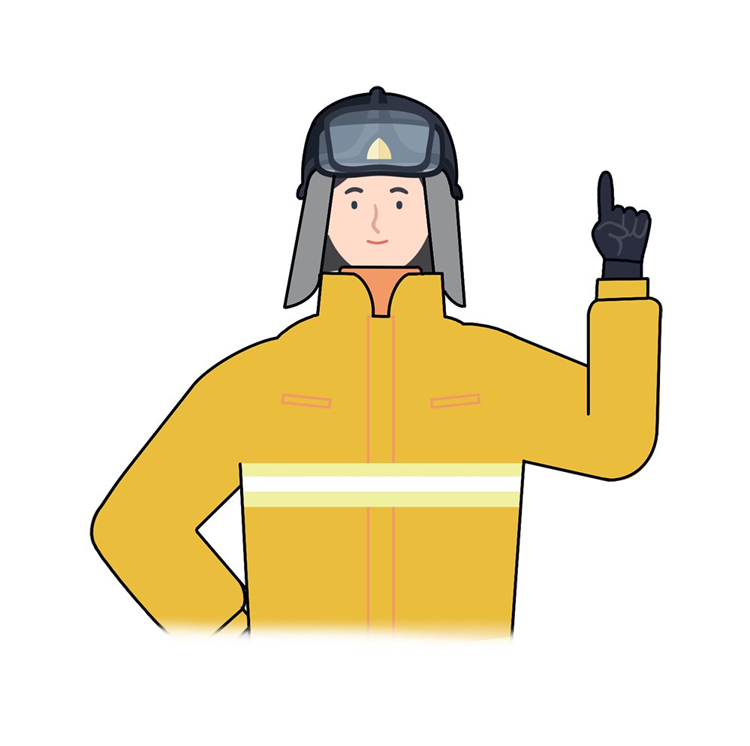
*
Key Points for Fire Safety
“
Cold weather causes the demand for heating appliances increase, which easily lead to a fire
In case of a fire or burn, call 119 immediately
Enjoy a comfortable and safe winter in Korea
“
Disabled
Woman
Elderly
Foreigner

Slide 14
Fire Safety in Winter
Fire safety training is the foundation for a safe society and happy people

